Slide 1

Spain Electricity Shortfall Challenge
Team 14

Slide 2

Table of Contents:
Introduction
Problem Statement
Exploratory Data Analysis (EDA)
Data Engineering
Model Performance
Conclusion

Slide 3

Introduction :
Spain considering expansion of its renewable energy resource.
Model shortfall between fossil and renewable resource energy.
Spain needs trends and patterns on energy generated.
Will renewable energy assist with minimizing energy shortfall.

Slide 4


Problem Statement:
Tasked to model the shortfall between energy generated by fossil fuels and renewable sources for the country of Spain.
Energy Generated
Fossil Fuel
Renewable Sources
Shortfall

Slide 5

Exploratory Data Analysis:

Slide 6
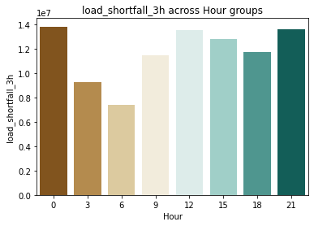
Load Shortfall during the day:
Load Shortfall Across Hour Groups
Load Shortfall
Hour

Slide 7
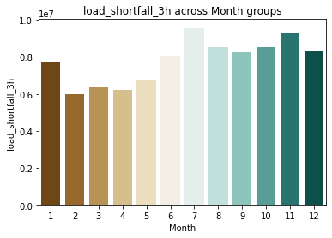
Load Shortfall During the year:
Load Shortfall Across Month Groups
Load Shortfall
Month
Notes:
Winter(DES-FEB) Spring(MAR-MAY) Summer(JUN-AUG) Autumn(SEP-NOV)

Slide 8
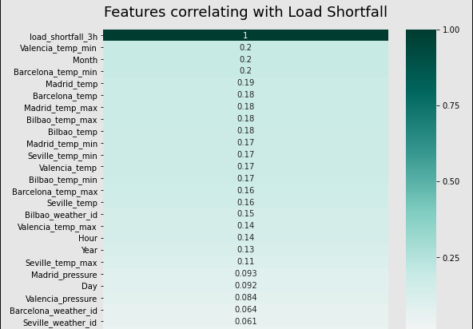
Features correlating Positive with load Shortfall graph:

Slide 9
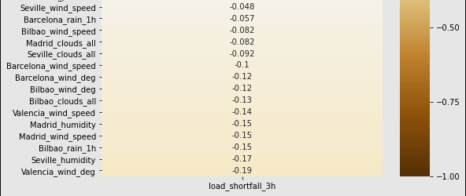
Features correlating Negative with load Shortfall graph:

Slide 10

Data engineering
Creating regression models.

Slide 11






Devide Dataset:
City Specific Weather
Load Shortfall
X = Features or independent variables.
Y = Dependent variable.

Slide 12

Standardisation and why we used it:
Scaling technique that does not suffer from outliers and doesn’t contain it in a [0,1] range.
Why its important ?
Why not normalization ?
Suffer from outliers by squeezing data into [0,1] range making the bulk of the data lie in a small range.
Critical to regularisation which puts constraints on the size of the coefficients related to each variable.

Slide 13
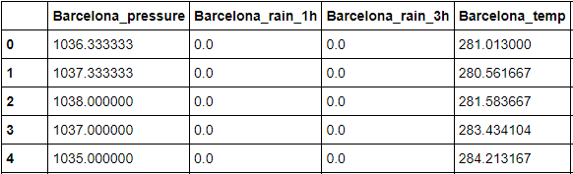
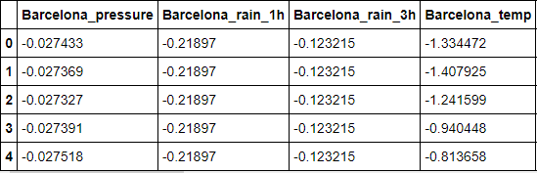
Data before and after stadardisation:
Before:
After:
Using standardisation we rescale all the features to fit on the same scale, to make the regularisation techniques more effective.

Slide 14
Root Mean Square Error (RMSE) :
Standard way to measure the error of a model in predicting quantitative data.
 | Decision Tree | Kneighbor- Regressor | Linear Regression | Ridge Regression | XGBooster Regressor
RMSE | 6187,23 | 4765,01 | 4848,57 | 4841,21 | 4361,64

Slide 15

XGBRegressor (Extreme Gradient Boosting) :
We used XGRegressor because of the Computation speed, Parallelization and Performance.
Scores better then individual models.
Scalable and accurate

Slide 16
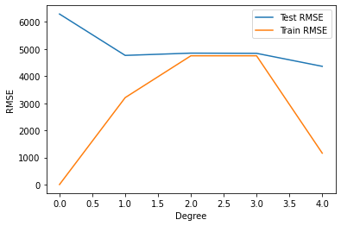

Model Performance:
Model Execution of 0,389 Seconds
RMSE value of 4361,64
0 = Decision Tree
1 = KNeighbors
2 = Linear
3 = Ridge
4 = XGB

Slide 17
Conclusion:
Date And Time | Load Shortfall
2018-01-01 03:00:00 | 7745,50
2018-01-01 09:00:00 | 8704,17
2018-01-01 15:00:00 | 12122,20
2018-01-01 21:00:00 | 15072,94
Date And Time | Load Shortfall
2018-12-31 03:00:00 | 8032,17
2018-12-31 09:00:00 | 10928,07
2018-12-31 15:00:00 | 12495,57
2018-12-31 21:00:00 | 14453,69
Avg per day = 10716,82
Avg per day = 1110,35

Slide 18
Weather Features:
City | Temperature
Barcelona | 0,998
Bilboa | 1,010
Madrid | 0,994
Seville | 1,051
Valencia | 1,011
City | Wind Speed
Barcelona | 1,214
Bilboa | 1,139
Madrid | 1,157
Seville | 1,066
Valencia | 1,371
City | Rain
Barcelona | 1,047
Bilboa | 1,632
Madrid | -
Seville | 1,487
Valencia | -

Slide 19
Extra Slides:

Slide 20
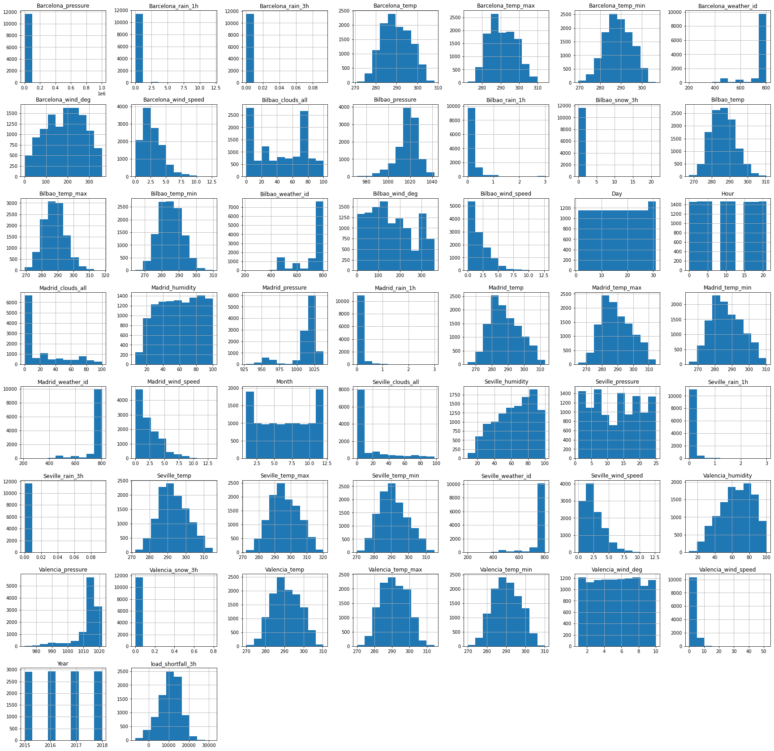
Histogrtam

